Slide 1

Arrays And Strings
Session#4

Slide 2
Session’s Agenda
Arrays
Strings
Vectors (Dynamic Array)

Slide 3
Arrays
C++ Array Declaration
Access Elements in C++ Array
C++ Array Initialization
C++ Array With Empty Members
Example 1: Displaying Array Elements
Example 2: Take Inputs from User and Store Them in an Array
Example 3: Display Sum and Average of Array Elements Using for Loop
C++ Array Out of Bounds

Slide 4
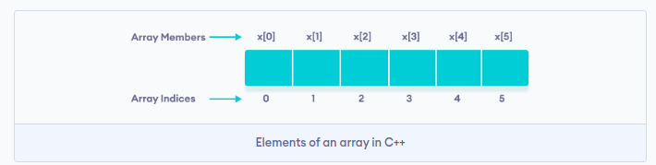
Declaration and Accessing Elements

Slide 5
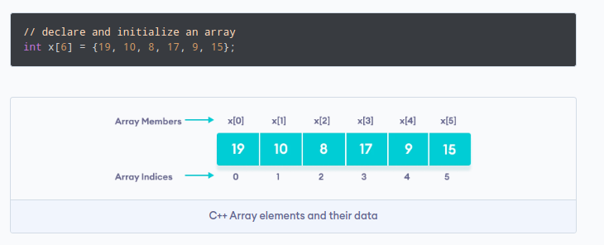
Array Initialization

Slide 6
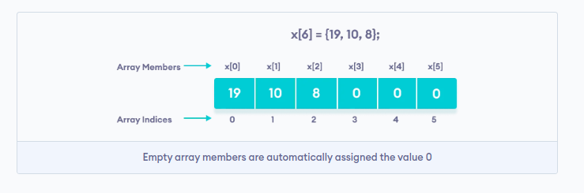
Array With Empty Members

Slide 7
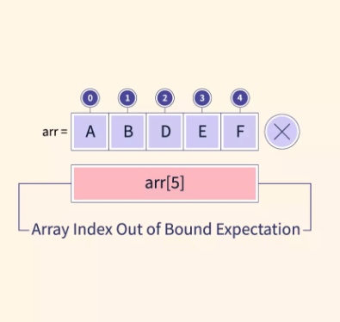
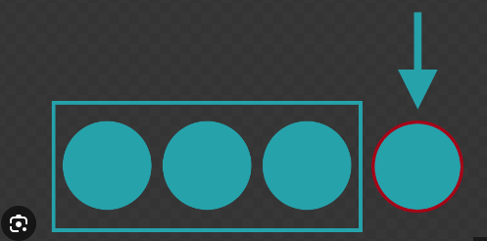
Array Out of Bounds!

Slide 8
Strings
C++ String VS C string
String and getline
String Member Functions
Strings and lexicographical order

Slide 9
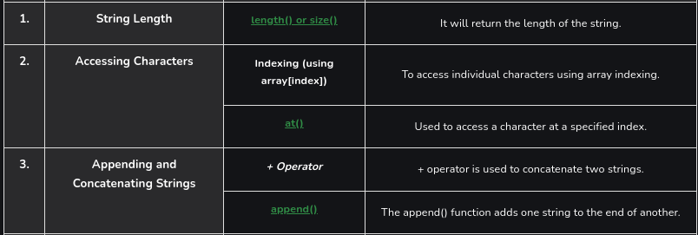
String Member Functions

Slide 10
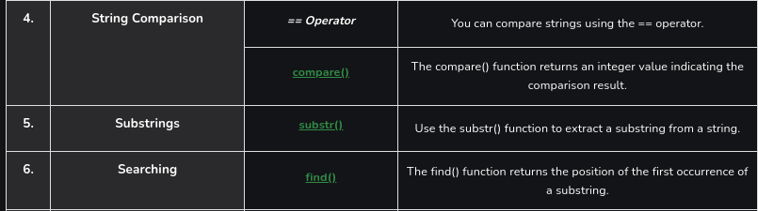
String Member Functions

Slide 11
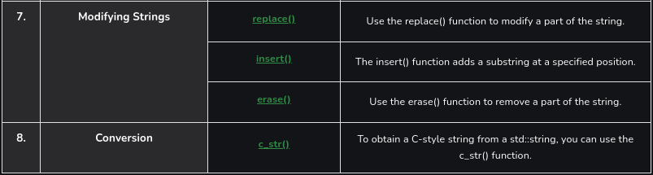
String Member Functions

Slide 12
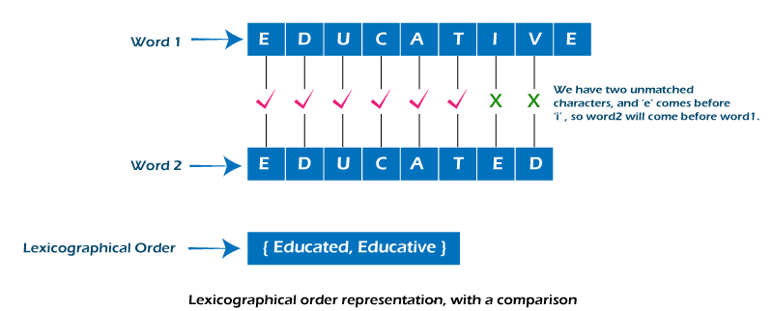
Strings and lexicographical order

Slide 13
Vectors (Dynamic Array)
Vectors VS normal Arrays
Vectors VS Strings
How to use vectors
Vector member functions

Slide 14
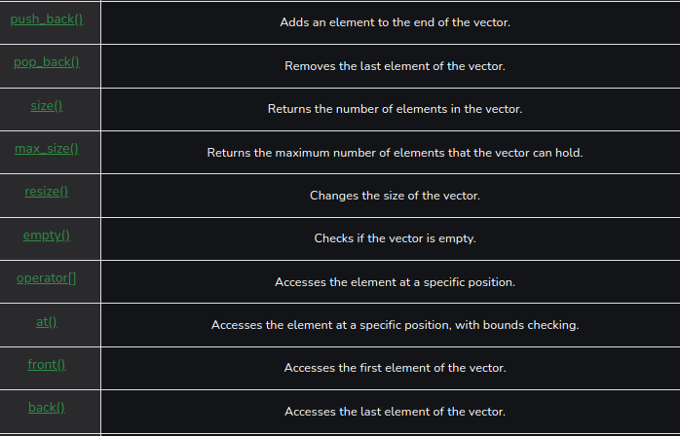
Vectors (Dynamic Array)
Vector
member
functions

Slide 15
More Materials
Arrays
Strings
Vector
Passing Arrays Function

